Slide 1
Google File System
Engineering Big-Data Systems
Rohit Agarwal

Slide 2
Overview
Introduction-Design Overview
Architecture
System Interactions
Master Operations
Fault tolerance
Conclusion

Slide 3
Introduction
Need For GFS:
Large Data Files
Scalability
Reliability
Automation
Replication of data
Fault Tolerance

Slide 4
Design Overview:
Assumptions:
Component’s Monitoring
Storing of huge data
Reading and writing of data
Well defined semantics for multiple clients
Importance of Bandwidth
Interface:
Not POSIX compliant
Additional operations
  Snapshot
  Record append

Slide 5
Architecture:
Cluster Computing
Single Master
Multiple Chunk Servers
Multiple clients
Stores 64 bit file chunks

Slide 6
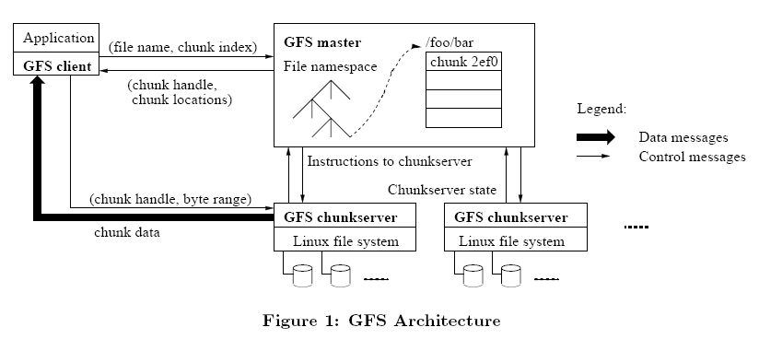

Slide 7
Single Master , Chunk size & Meta data
Single Master:
Minimal Master Load.
Fixed chunk Size.
The master also predicatively provide chunk locations immediately following those requested by unique id.
Chunk Size :
64 MB size.
Read and write operations on same chunk.
Reduces network overhead and size of metadata in the master.

Slide 8
Metadata :
Types of Metadata:
  File and chunk namespaces
  Mapping from files to chunks
  Location of each chunks replicas
In-memory data structures:
  Master operations are fast.
  Periodic scanning entire state is easy and efficient

Slide 9
Chunk Locations:
  Master polls chunk server for the information.
  Client request data from chunk server.
Operation Log:
  Keeps track of activities.
  It is central to GFS.
  It stores on multiple remote locations.

Slide 10
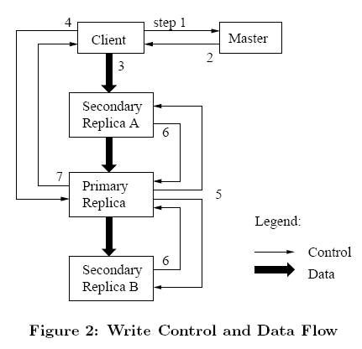
System Interactions:
Leases And Mutation order:
Leases maintain consistent mutation order across the replicas.
Master picks one replica as primary.
Primary defines serial order for mutations.
Replicas follow same serial order.
Minimize management overhead at the master.

Slide 11
Atomic Record Appends:
GFS offers Record Append .
Clients on diﬀerent machines append to the same ﬁle concurrently.
The data is written at least once as an atomic unit.
Snapshot:
It creates quick copy of files or a directory .
  Master revokes lease for that file
  Duplicate metadata
  On first write to a chunk after the snapshot operation
    All chunk servers create new chunk
    Data can be copied locally

Slide 12
Master Operation
Namespace Management and Locking:
GFS maps full pathname to Metadata in a table.
Each master operation acquires a set of locks.
Locking scheme allows concurrent mutations in same directory.
Locks are acquired in a consistent total order to prevent deadlock.
Replica Placement:
Maximizes reliability, availability and network bandwidth utilization.
Spread chunk replicas across racks

Slide 13
Creation, Re-replication, Rebalancing
Create:
Equalize disk utilization.
Limit the number of creation on chunk server.
Spread replicas across racks.
Re-replication:
Re-replication of chunk happens on priority.
Rebalancing:
Move replica for better disk space and load balancing.
Remove replicas on chunk servers with below average free space.

Slide 14
Garbage Collection:
Makes system Simpler and more reliable.
Master logs the deletion, renames the file to a hidden name.
Stale Replica detection:
Chunk version number identifies the stale replicas.
Client or chunk server verifies the version number.

Slide 15
Fault Tolerance
High availability:
Fast recovery.
Chunk replication.
Shadow Masters.
Data Integrity:
Check sum every 64 kb block in each chunk.

Slide 16
Conclusion
GFS meets Google storage requirements:
Incremental growth
Regular check of component failure
Data optimization from special operations
Simple architecture
Fault Tolerance

Slide 17


